Slide 1
moose for dcs world setup guides 2.0

Slide 2
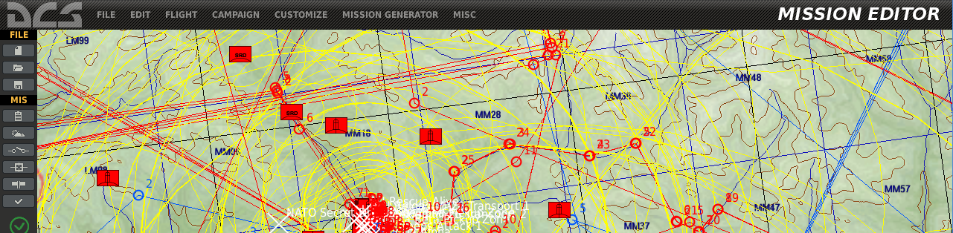
videos explaining how to setup your environment

Slide 3
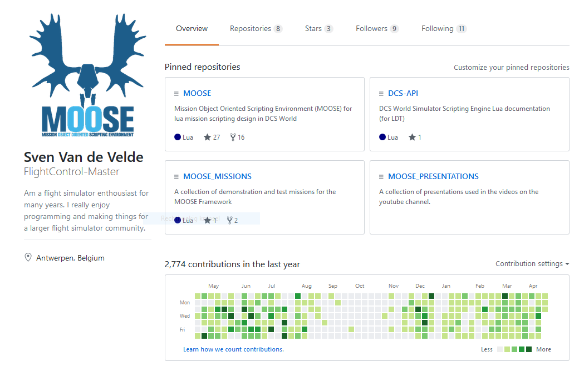
different repositories
MOOSE Repositories on GITHUB.COM
MOOSE
The MOOSE framework code base and installation components.
The code base is located in the Moose Development folder.
MOOSE_MISSIONS
Demonstration missions, explaining scenarios how to apply the framework.
MOOSE_PRESENTATIONS
Various presentations and logo materials used in publishing channels.

Slide 4
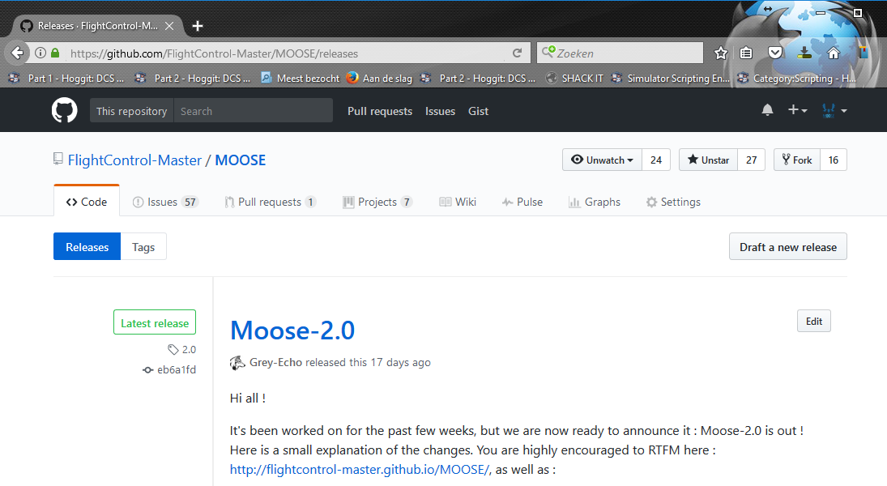
release process
MOOSE Main Release Download Location
Main URL: github.com/FlightControl-Master/MOOSE/releases
This is the main site where you
need to download the moose
package zip files.
Each new release will be published
here!

Slide 5
GIT Branch Management
Feature Freeze
-
Pre Release
Release 2.0
Hotfix Release 2.0.1
Release 2.1
Master-Release
All issues closed for 2.1 Milestone
Master
Bugfixes
People can still work on new features, but no merge to master allowed during feature freeze
Features
Feature not ready for 2.1
Current Release : 2.0
Next Release : 2.1
Current Release : 2.0.1
Next Release : 2.1
Current Release : 2.1
Next Release : 2.2

Slide 6
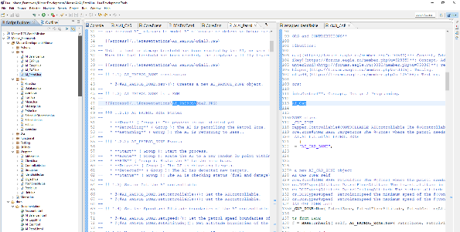
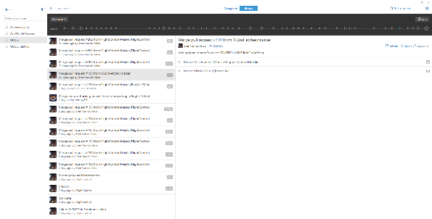
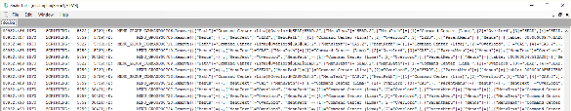
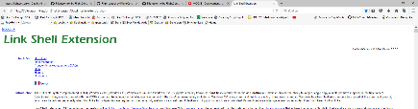

various tools augment the mission design experience
MISSION EDITOR
ECLIPSE ENVIRONMENT
GIT HUB DESKTOP
TOOLS
LOGGING TRAILING
UTILITIES …

Slide 7
ldt setup

Slide 8
moose for dcs world setup for a normal user

Slide 9
moose for dcs world LUA DEV TOOLS (LDT) SETUP

Slide 10
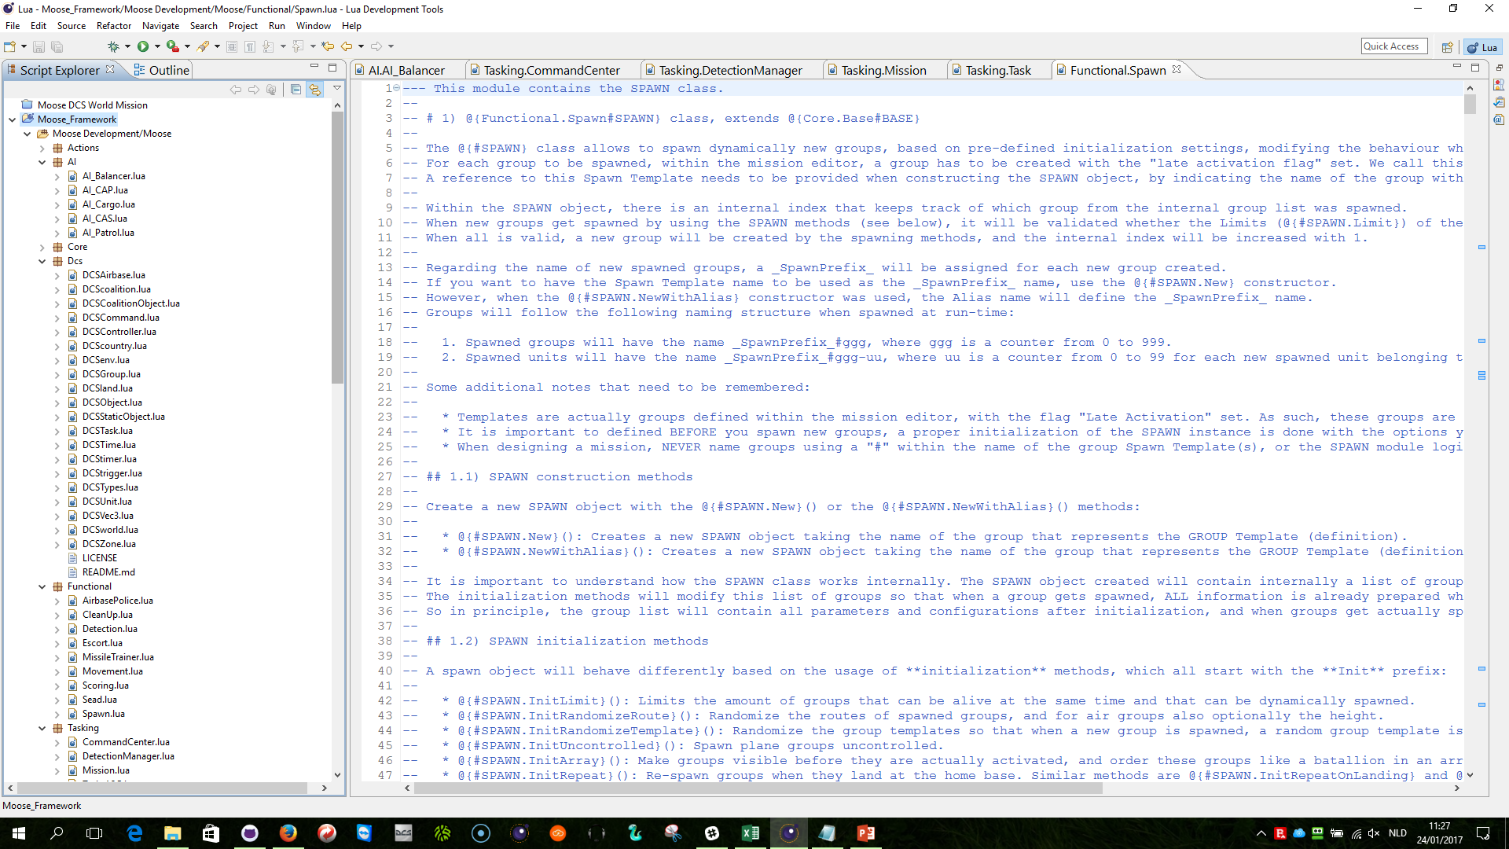
ldt setup
LDT: https://eclipse.org/ldt/
JAVA: https://java.com/en/download/

Slide 11
moose for dcs world setup demo missions in ldt

Slide 12
moose for dcs world setup YOUR missions in ldt

Slide 13
moose for dcs world GITHUB desktop setup

Slide 14
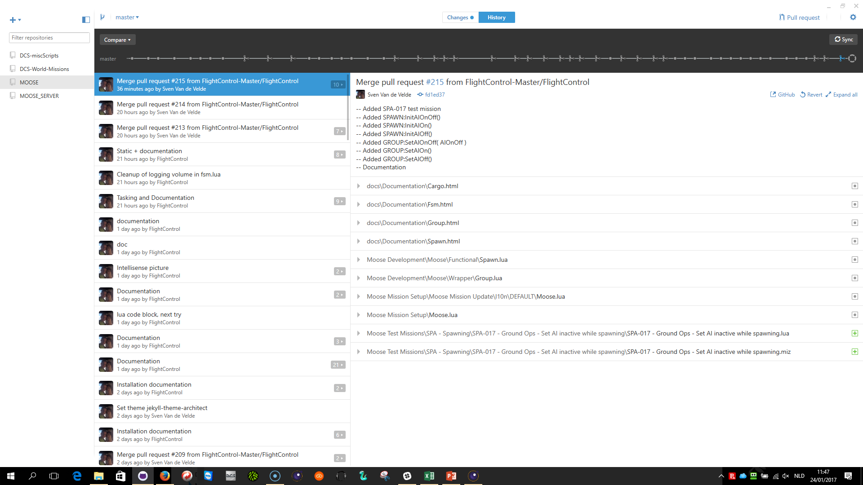
GITHUB DESKTOP SET
GITHUB DESKTOP: https://desktop.github.com/
MOOSE: https://github.com/FlightControl-Master/MOOSE

Slide 15
moose for dcs world Synchronize the DCS submodule from github

Slide 16
work in progress 1

Slide 17
moose for dcs world interactive debug in ldt

Slide 18
work in progress 2
WE CAN NOW WALK THROUGH THE CODE!!!

Slide 19
moose for dcs world dynamic loading

Slide 20
What is MOOSE dynamic loading?
DCS WORLD
LUA Environment
Mission.miz
DO SCRIPT FILE trigger Moose.lua
Moose folder is added to ED installation Scripts folder
Load
1
X:\PF\Eagle Dynamics\DCS World\Scripts\Moose\*.lua

Slide 21
advantage (1) – github updates
DCS WORLD
GITHUB
LUA Environment
MOOSE
Mission.miz
DO SCRIPT FILE trigger Moose.lua
Pull (Sync)
2
3
Load
Link
X:\PF\Eagle Dynamics\DCS World\Scripts\Moose\*.lua
Y:\MOOSE\Moose Development\Moose

Slide 22
advantage (2) – development
DCS WORLD
Develop (Eclipse LDT)
LUA Environment
Mission.miz
DO SCRIPT FILE trigger Moose.lua
Development
4
Load
Link
X:\PF\Eagle Dynamics\DCS World\Scripts\Moose\*.lua
Y:\MOOSE\Moose Development\Moose

